Slide 1


DEVELOPMENT PROJECT OF ENVIRONMENTAL TECHNOLOGY FOR CLIMATE CHANGE
Model Of inTegrated Impact and Vulnerability Evaluation of climate change
- MOTIVE -
Dr. Young-Il Song
Korea Environment Institute

Slide 2
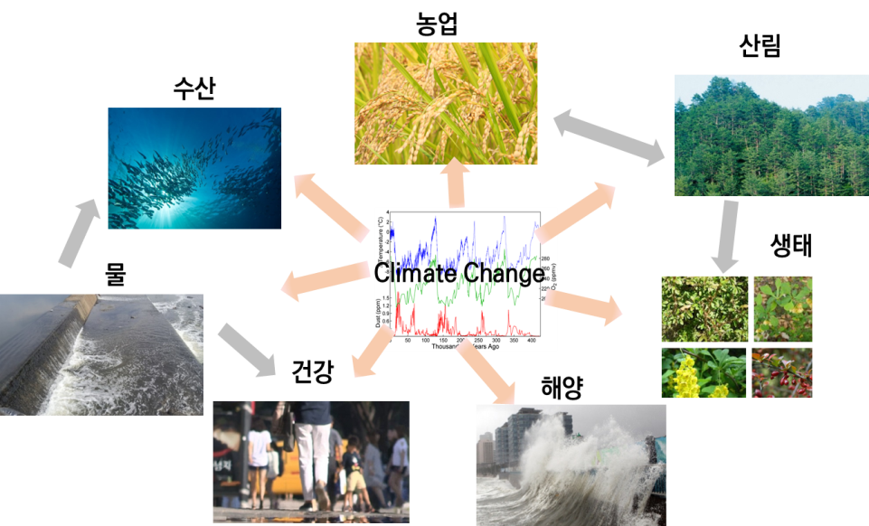
Background
Lack of integrated impact and vulnerability assessment based on scientific evidence
- Climate change impact and vulnerability assessment without considering across different sectors
- Use of different DB for each study, Index-based assessment with weight values by expert opinions
- Need to establish scientific climate change adaptation policies with minimization of mal-adaptation
- Development of 'Risk Assessment' to communicate with adaptation policy
※ to utilize setting priority of adaptation plan
< Concept of Integrated Assessment Model >
Agriculture
Fishery
Forestry
Sector 1
Sector 3
Sector 2
Individual model
Water
Eco-System
linkage model
Health
Ocean
linkage model
Integrated model

Slide 3
Outline
(Sectoral Assessment Factors & Policy Application)
Scopes
project period | 2014.05.01. ~ 2021.03.31.
Resolution | South Korea, 1km x 1km (an administrative district, basin as a unit)
User | Central/Local Government, Researchers, Industry, etc.
Scenario | RCP4.5 & 8.5 / KMA (HadGEM2-AO/HadGEM3-RA/PRISM) & KEI (CESM/WRF/DDS) Climate scenario
System | User-Friendly GUI(web&stand-alone) Based System
Sectors | Assessment Factors
Ocean /Fishery | 13 types such as Sea-level rise(flood, inundation), Fishery primary productivity, Productive capability, Biomass size and Red tide
Health | 9 types such as Heat wave, Air pollution, Infection and Vector-borne disease
Water | 16 types such as Water quantity/quality and Aquatic ecology
Forest | 9 types such as Species distribution, Forest growth, Carbon circulation, Forest disaster(landslide) and Land coverage change
Agriculture | 19 types such as Suitable land for cultivation, Crop productivity, Farmland greenhouse gas cycle, Pest and Eco-System service
Ecosystem | 2 types such as Disturbing species and Climate-sensitive species
Policy Application SOC Management Vulnerable Class Management Safety Management Conservation Area Management Food Production Supply Services

Slide 4
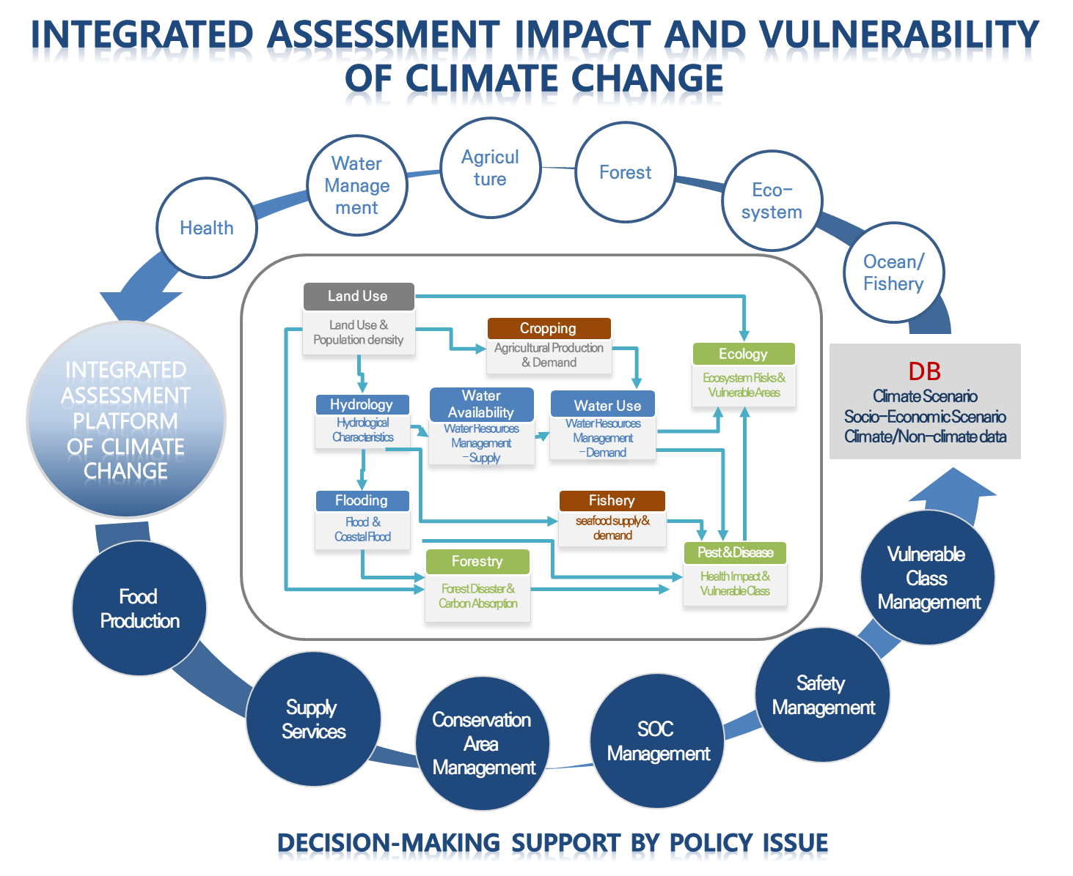
Goal
Development of integrated assessment model reflecting Korean circumstance to be utilized
for designing 'science-based adaptation strategies'
- Developing cross-sectoral integrated assessment model(MOTIVE)
Sectors: Health, Water,
Agriculture, Forest, Eco-System,
and Ocean/Fishery
(where all sectors partially include disaster components)
- Developing integrated assessment-based model & platform for assessing main policy issues related to climate change
(e.g. Preservation area management)
- Developing methodologies for outlining risk-centric adaptation policy and maximizing its application
4

Slide 5
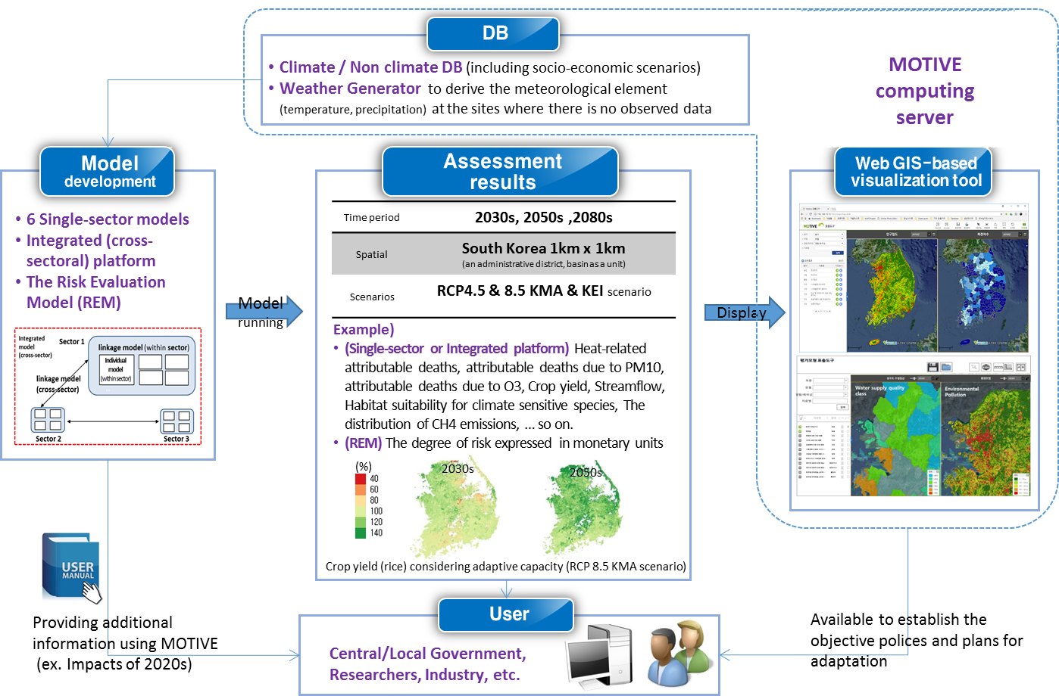
Goal
5

Slide 6
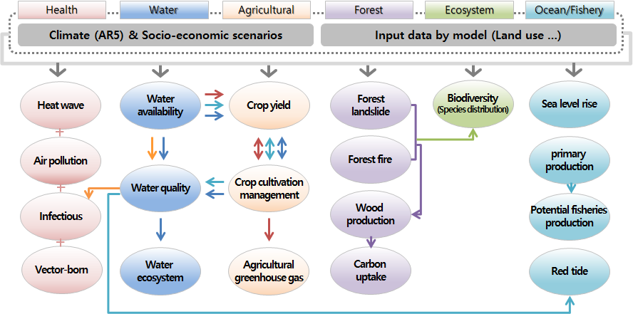
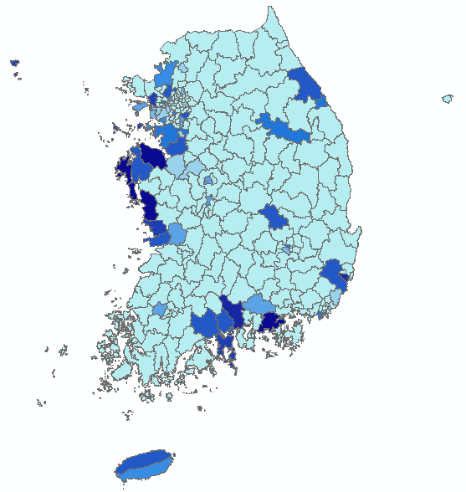

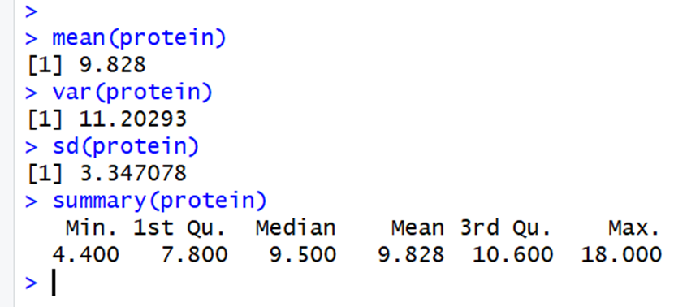
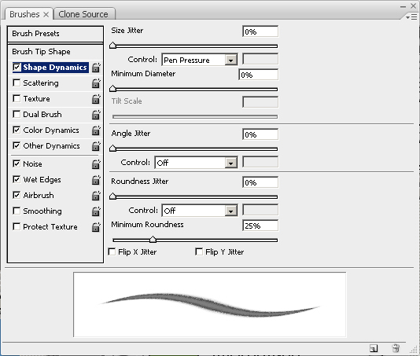
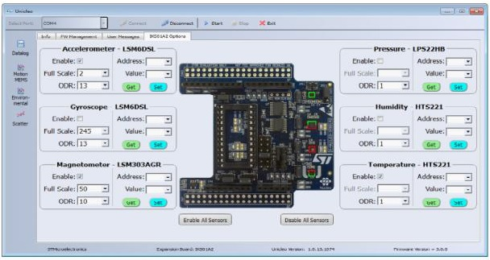
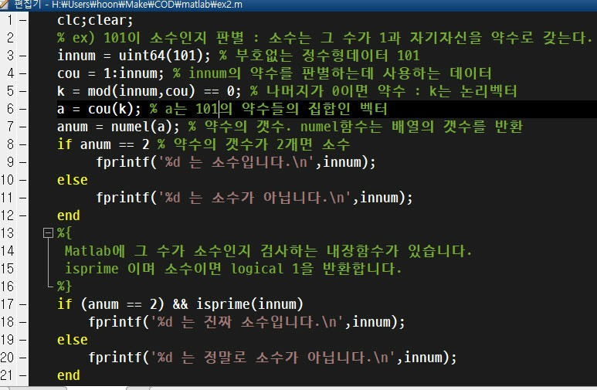
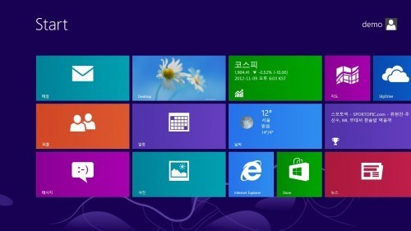
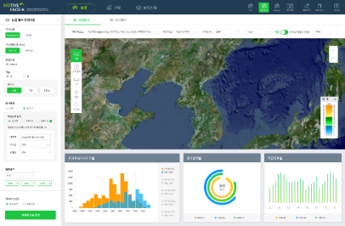
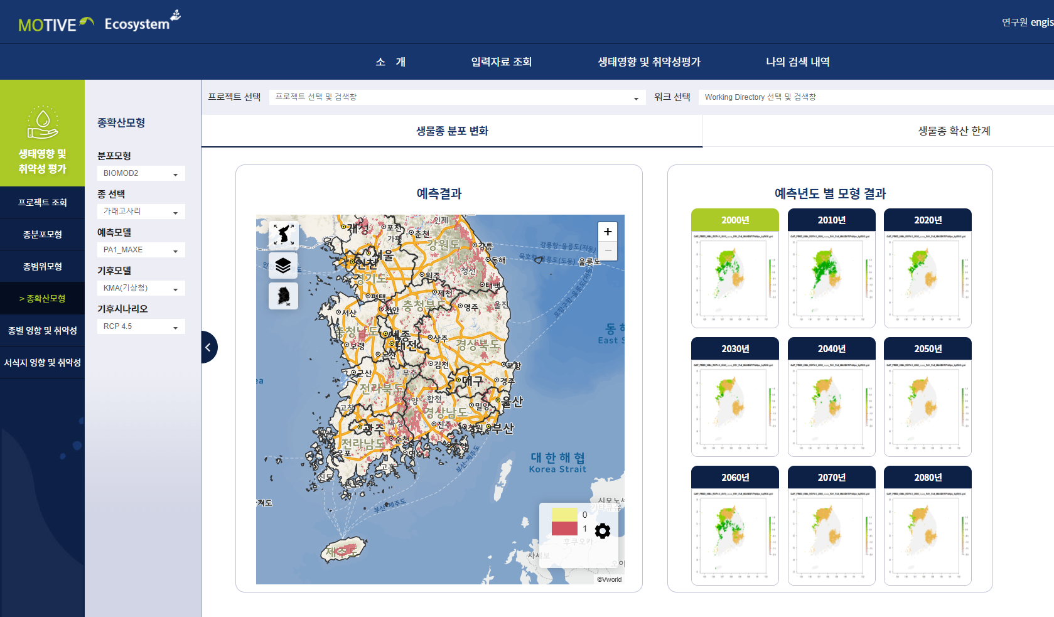
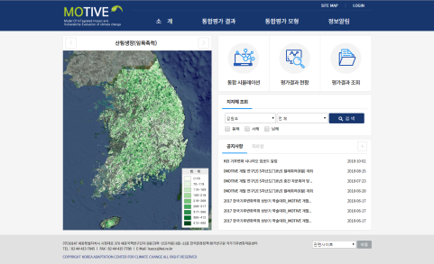
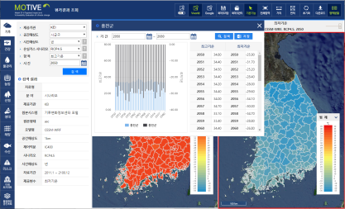
MOTIVE Development Procedure
DataBase Construction
Linkage Scenario
set up
Climate Scenario : KMA, KEI
Non-Climate DB : Integration and standardization of climate change
related information
Future land use : Reflecting the SSP scenario
Identification of inter-sectoral interactions and verification of model linkage
Ex) Estimation of agricultural production taking
into account water supply
Ex) Estimation of ecosystem changes in consideration
of forest fires and landslide
Ex)
Individual Sectoral CUI Model
Selection of factors greatly affected by climate change by sector
Model development in connection with factors
Ex) Forestry factor linkage model (disaster/ growth
/species/carbon absorption)
Health – CO Road Traffic Emissions
Health – Number of days
of wind damage
DBMS (Public)
GUI Development
Individual Sectoral CUI Model
Sectoral GUI Model
View model assessment result
68 assessment factors in 7 sectors
Ex) RCP 4.5, 2050s, number of deaths contributed
by heatwave
Strengthen user interface to enhance usability of various consumers
Sectoral GUI Model (Expert)
Enables user direct simulation model
Model based on linkage scenario and
in/out-put data
Ex) Eco-system model (Linkage with Forest disaster)
6

Slide 7
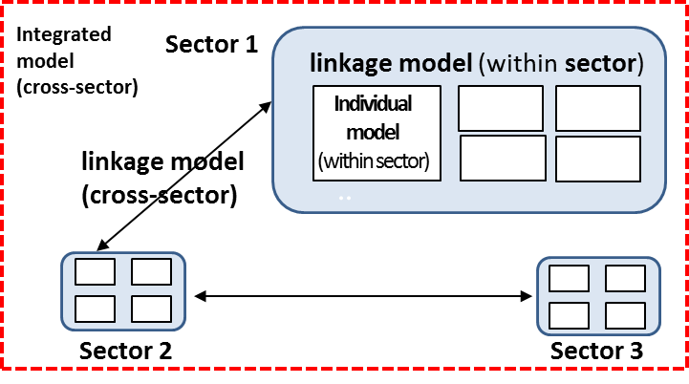
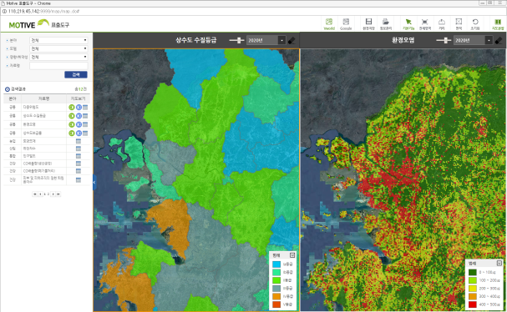
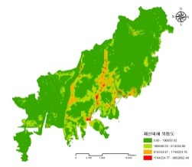
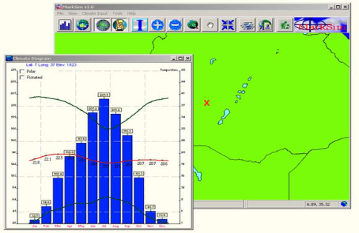
MOTIVE Composition
Single-sector models
and cross-sectoral models
to clearly identify
the interconnected impact
and vulnerability of climate change into each sector
The Integrated Assessment Platform (IAP) and The Integrated Spatial Model (ISM)
to undertake rapid simulations of integrated impacts and to discover adaptation strategies for minimizing
the climate change impacts
The Risk Evaluation Methodology (REM)
ties that bind adaptation
policies and applied simulations
Ex) The risk of property damage in Busan
Display tool
Web GIS-based
visualization tool
of MOTIVE
Climate (including KEI climate change scenario)
/Non-climate DB system for driving MOTIVE
and Korean Weather Generator
to derive the meteorological element (temperature, precipitation)
at the sites where there is no observed data
7

Slide 8
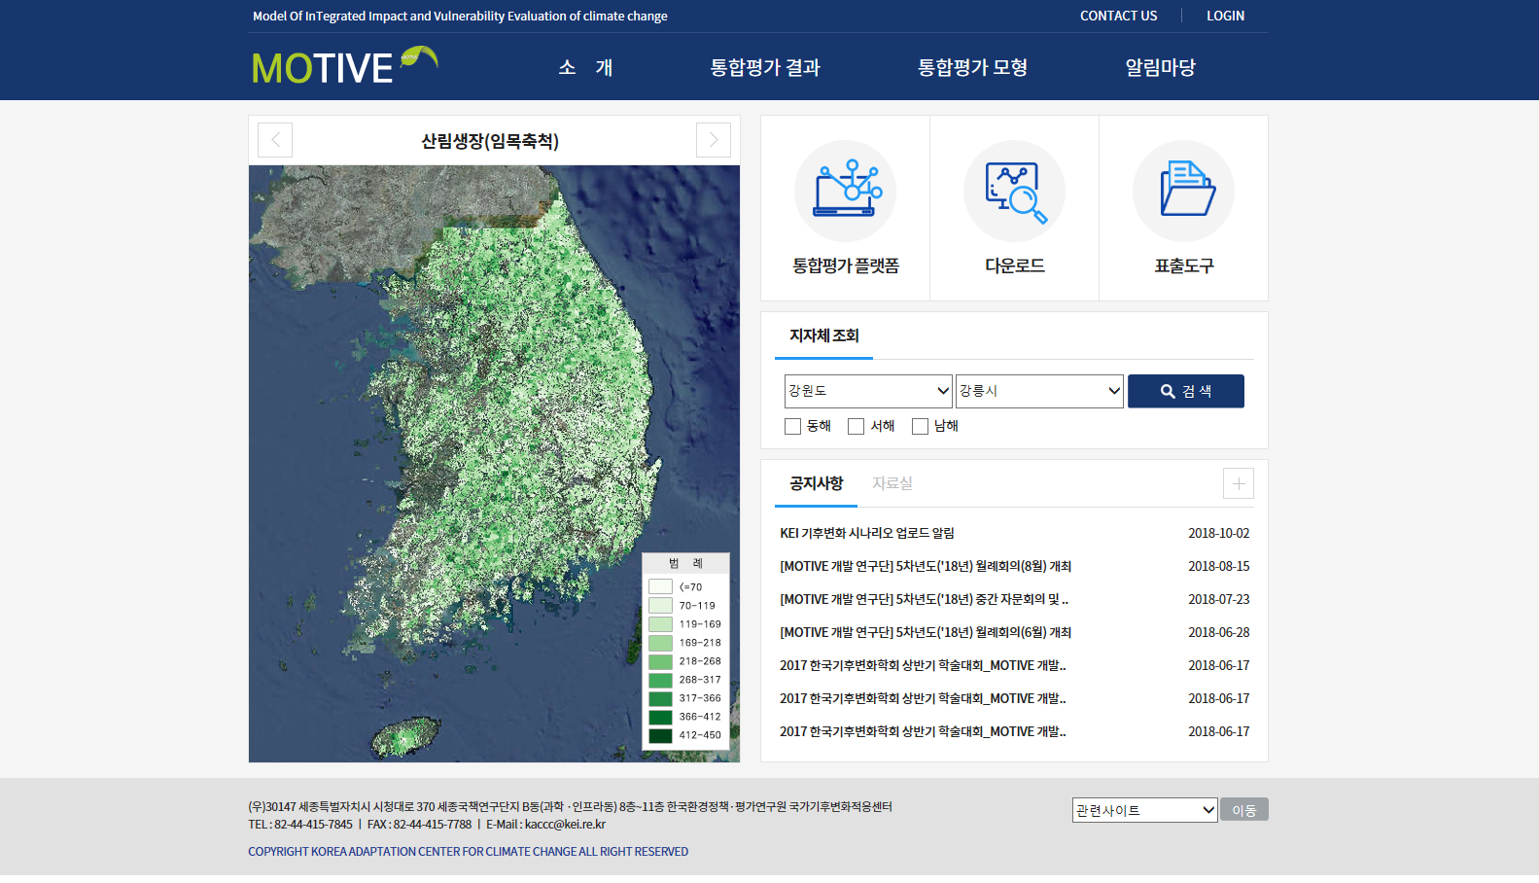
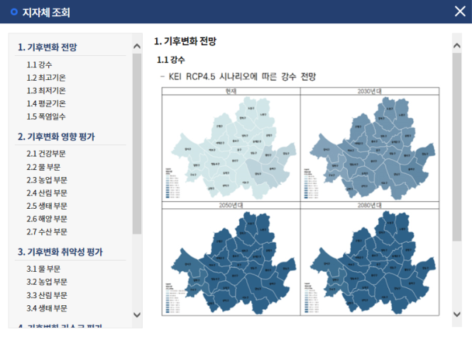
MOTIVE SYSTEM – HOMEPAGE
Introduction
Display tool - Climate change scenario & MOTIVE results
Sectoral Models & DB Download
Notice board
View results by local government
Providing the necessary data when establishing adaptation plan in the local government menu
8

Slide 9
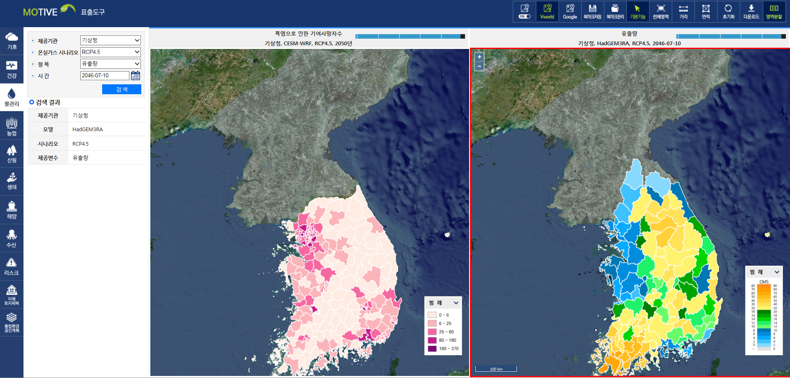
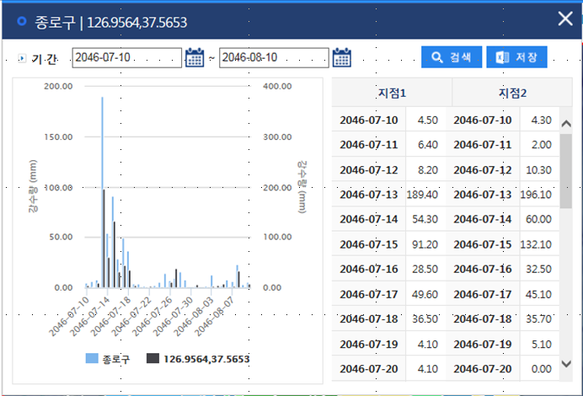
MOTIVE SYSTEM – RESULT VIEWING PAGE
Providing tables and graphs related to data
Climate Change Scenario
(KMA/KEI, RCP8.5/4.5)
2030/2040/2050/2080yr
Searching
for data
Save the map
9

Slide 10
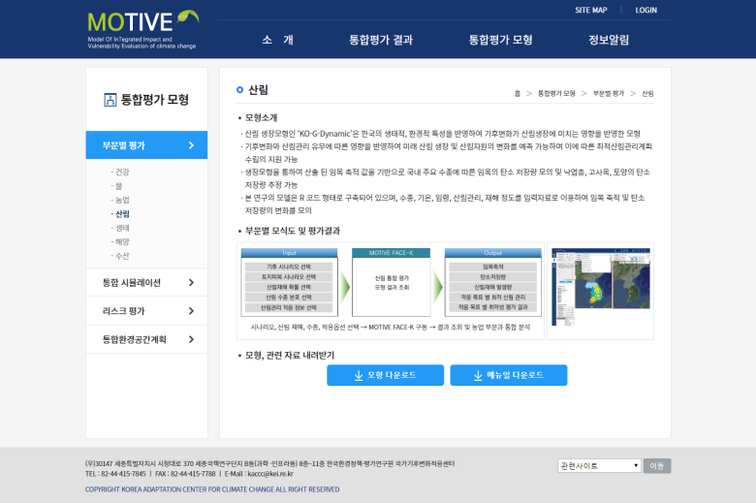
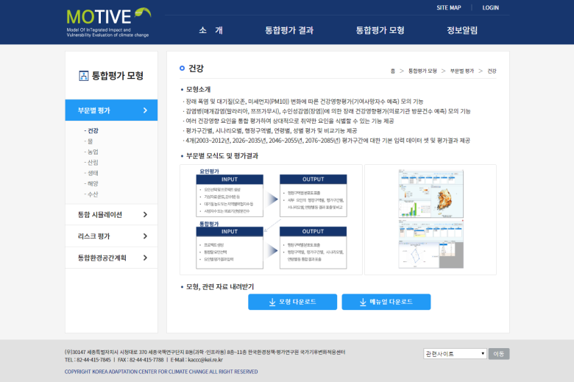
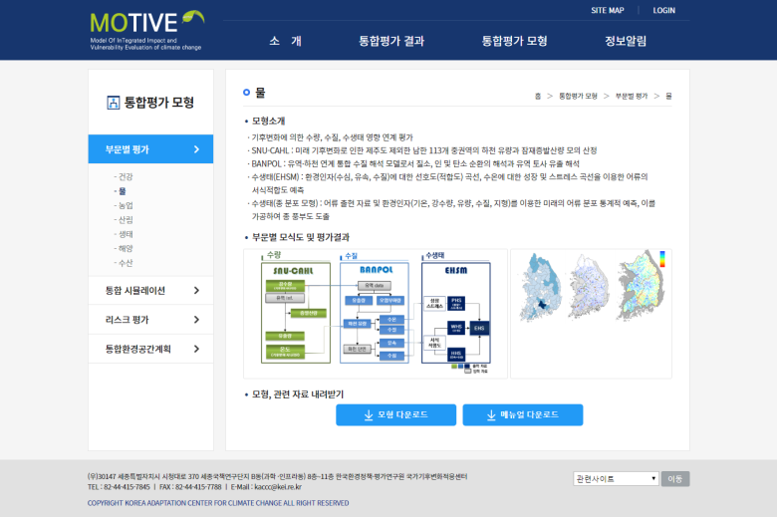
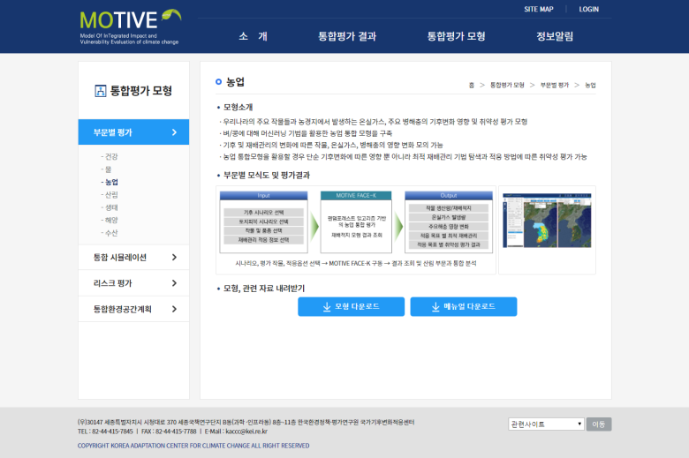
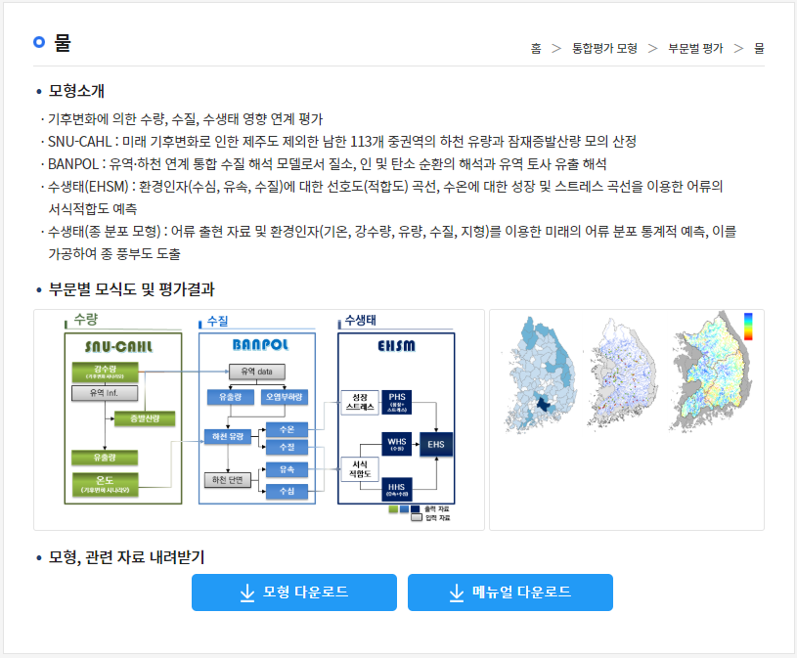
MOTIVE SYSTEM – SECTORAL MODEL PAGE
The introduction of sectoral models
Workflow for sectoral assessment
Download sectoral models and related materials
10

Slide 11
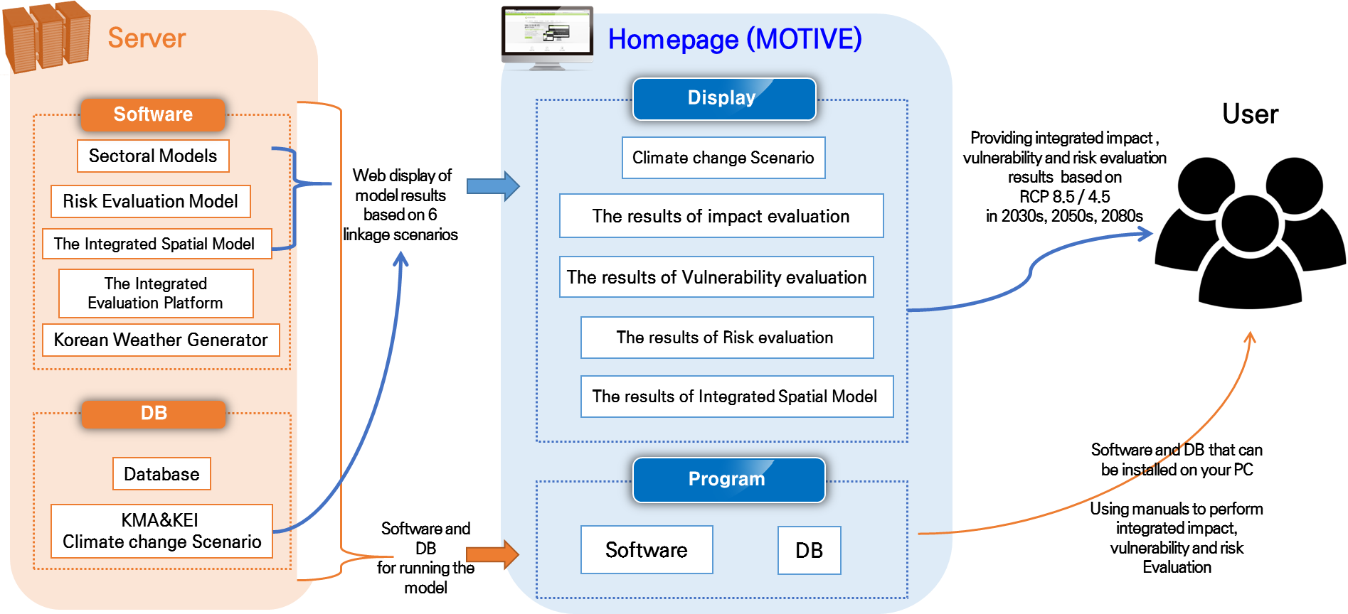

MOTIVE SYSTEM Operation
Integrated
Assessment Platform
11

Slide 12
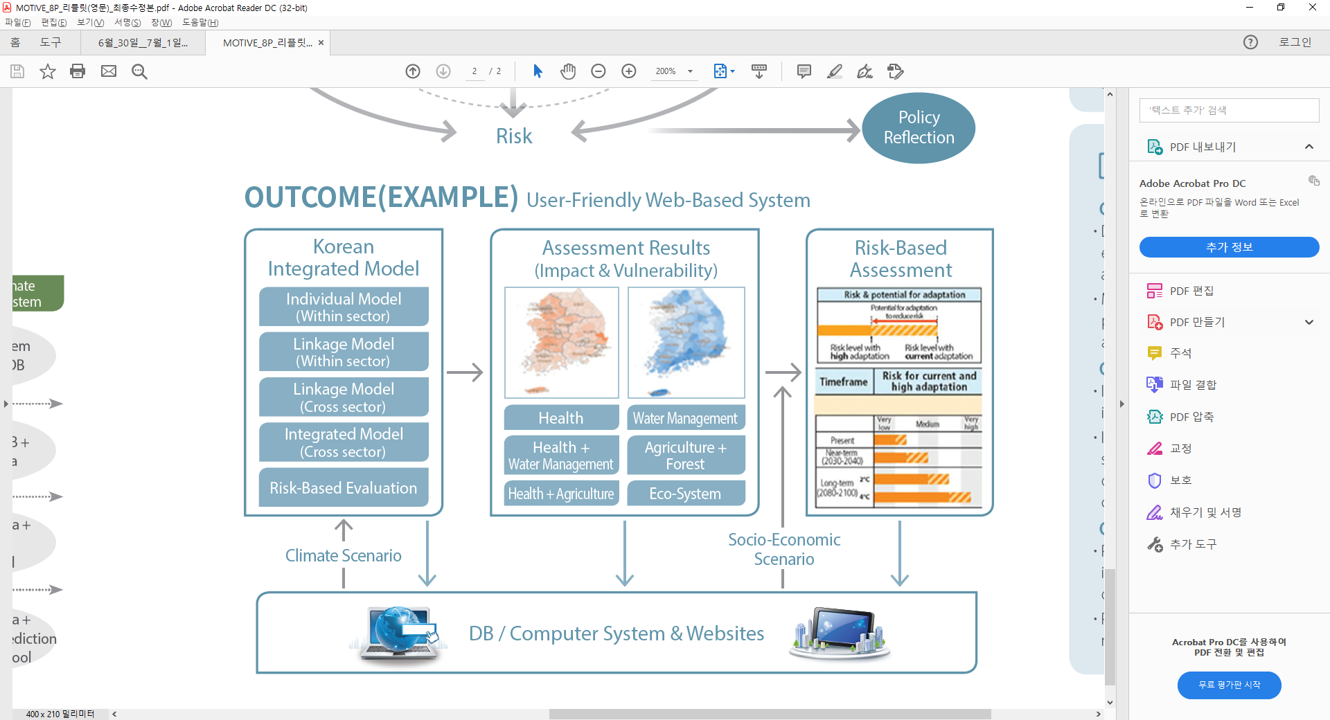
Outcomes and Effects
Diagram of Outcome
OUTCOME (User-Friendly GUI(web&stand-alone) Based System)
Effects
        On Policy
          -Establishment of foundation for efficient
          national climate change adaptation policy
          -Minimizing mal-adaptation by prioritizing based on scientific analysis
  On Industry and Economy
    -Increase the number of professional employment through creation of new jobs in climate change adaptation sector
  On Technology
    -Establishment of scientific grounds for integrated management technology of CC daptation
    -Establishment of national risk management system to cope with climate change
12

Slide 13
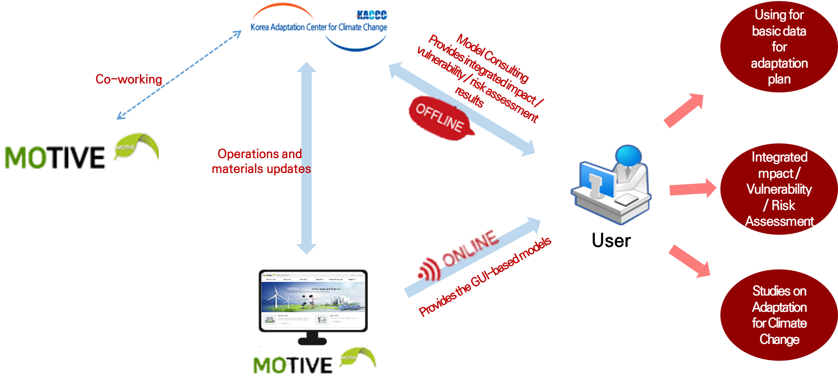
Outcomes and Effects
13

Slide 14

Thank You
very much !

